Slide 1
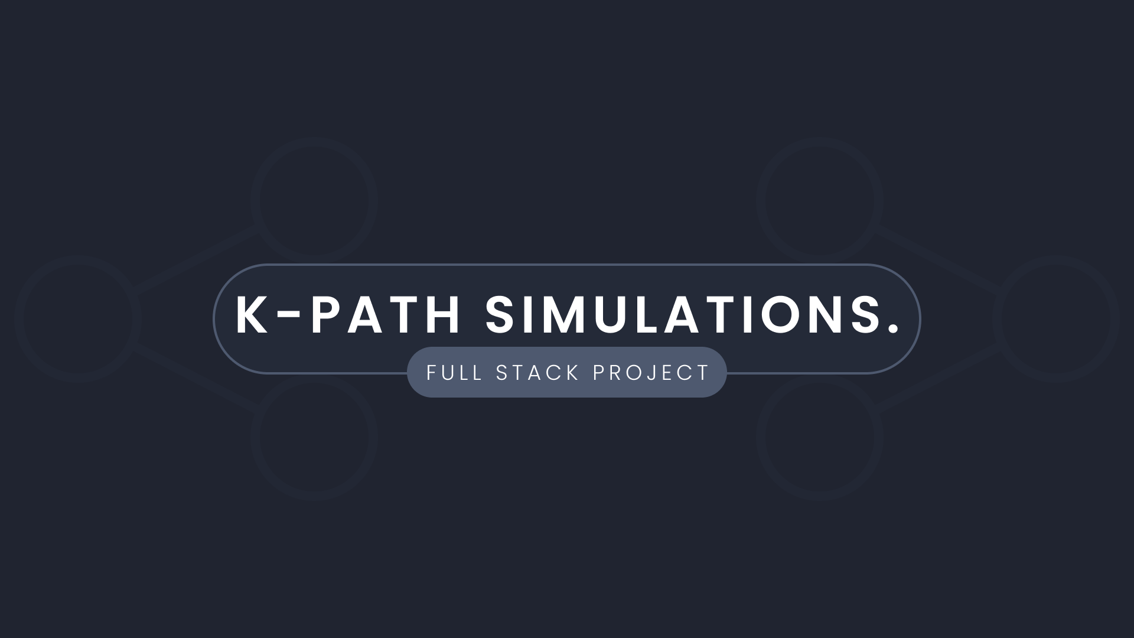

Slide 2
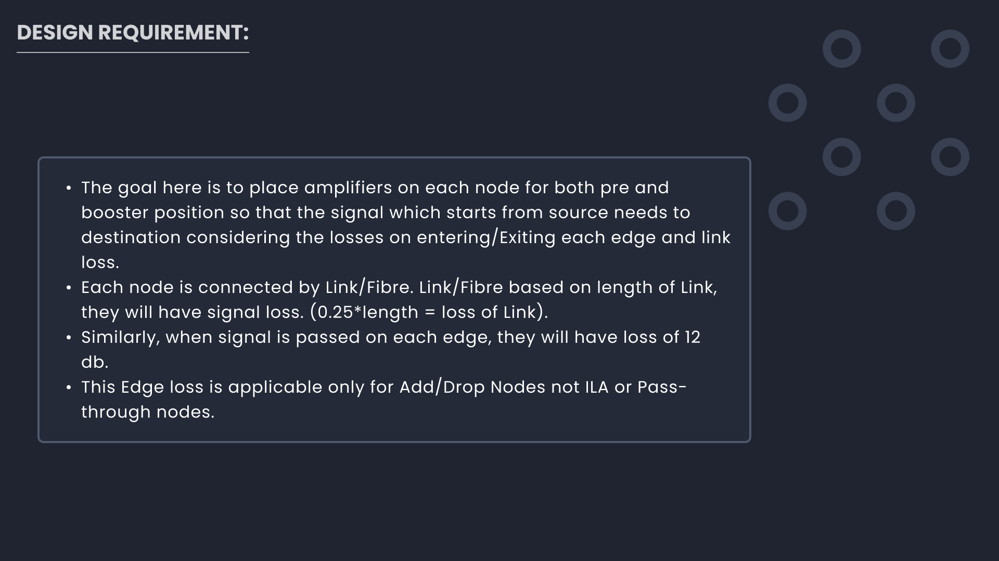

Slide 3




Displaying the analysed path in the frontend.
Implementing
K-Path Algorithm in java as per requirement.
003
Finding package for implementing nodes and links in frontend.
002
001

Slide 4
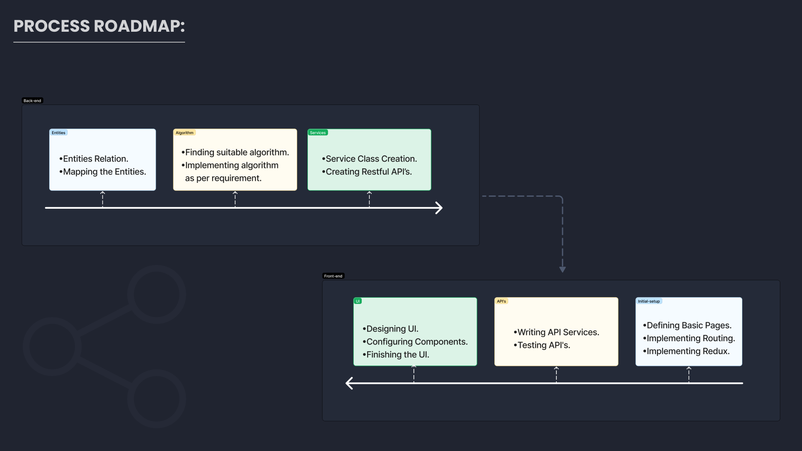

Slide 5
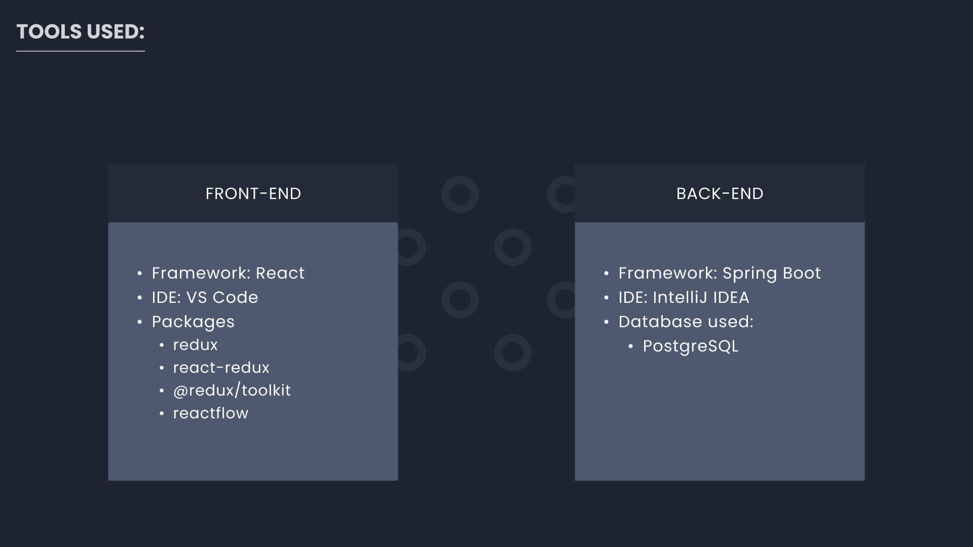

Slide 6





Users
Node
Link
Network

Slide 7

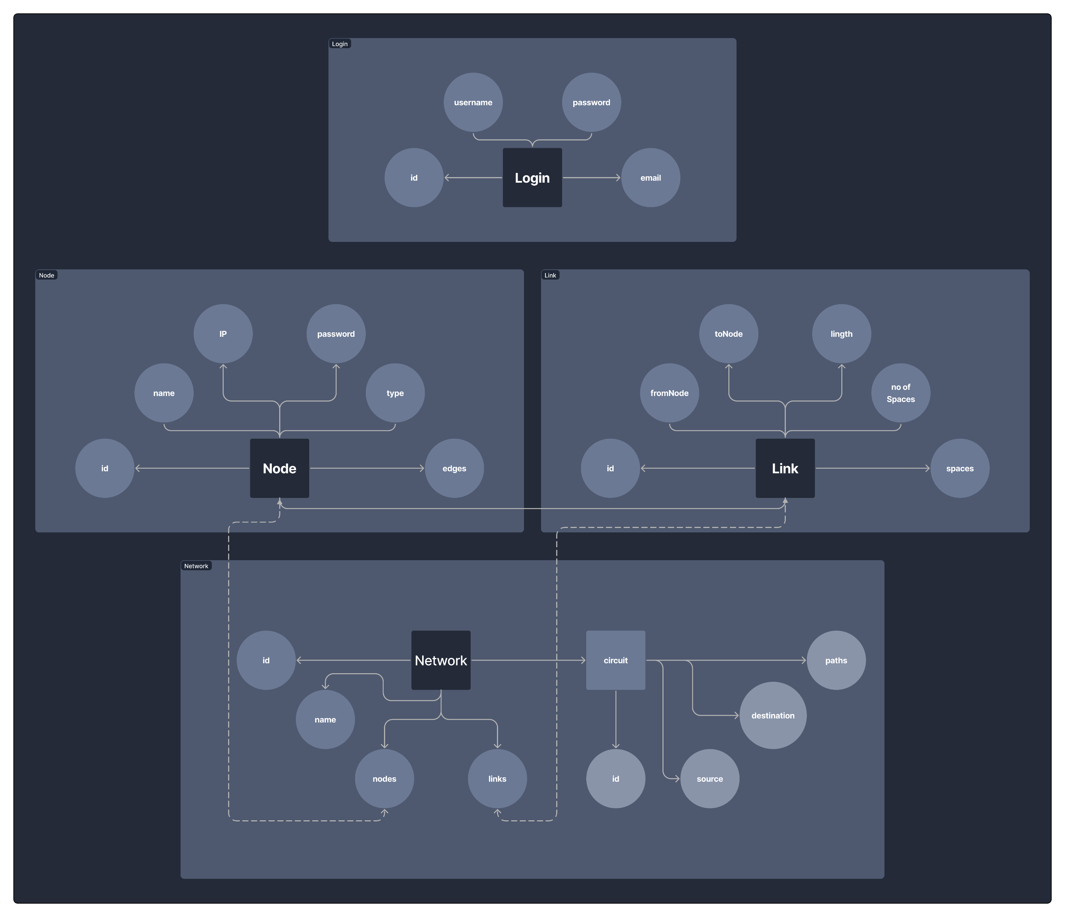

Slide 8
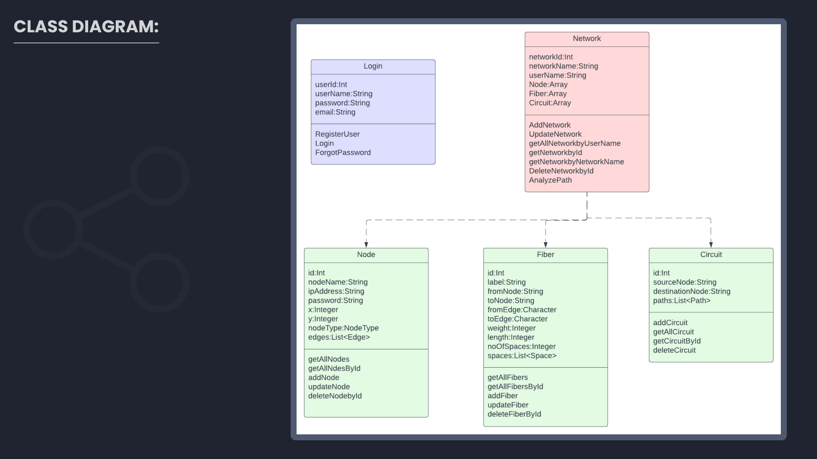

Slide 9
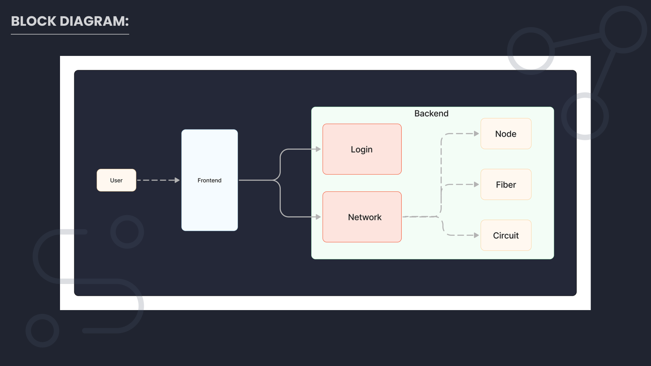

Slide 10

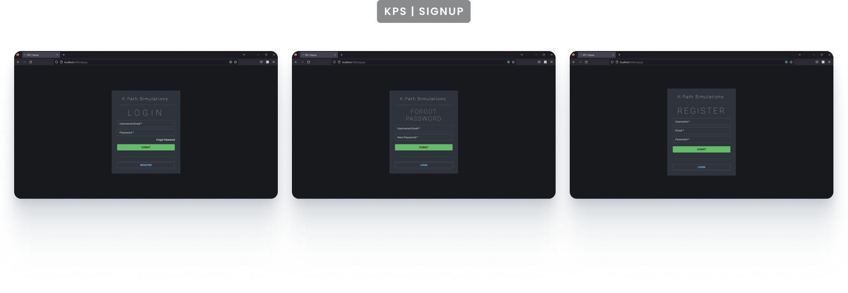


Slide 11
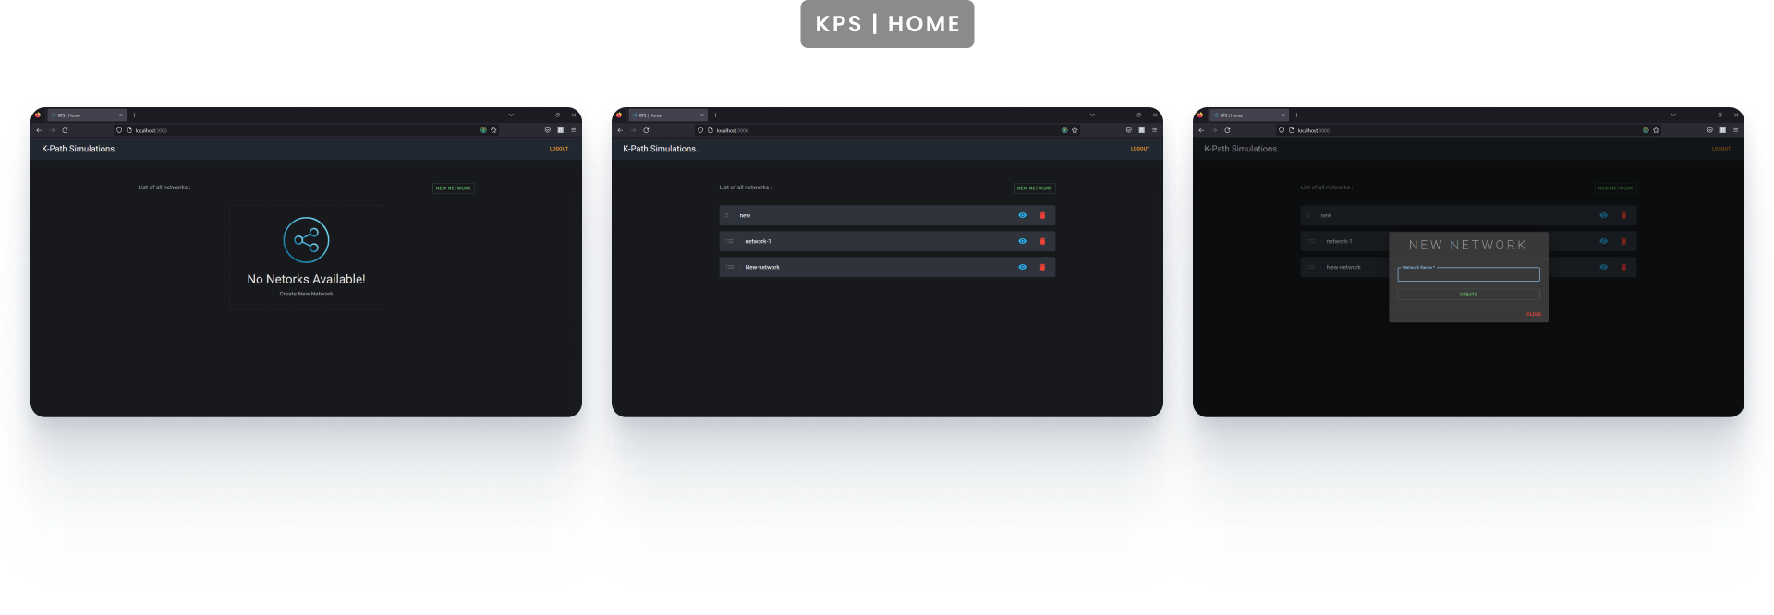


Slide 12
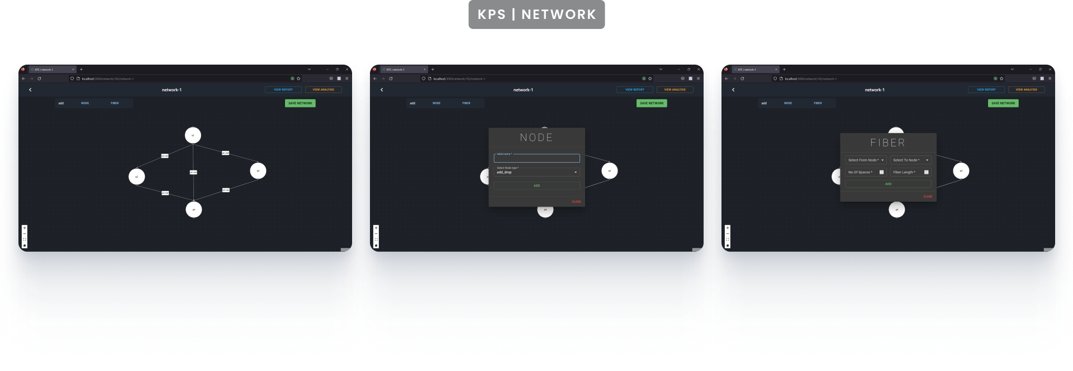


Slide 13
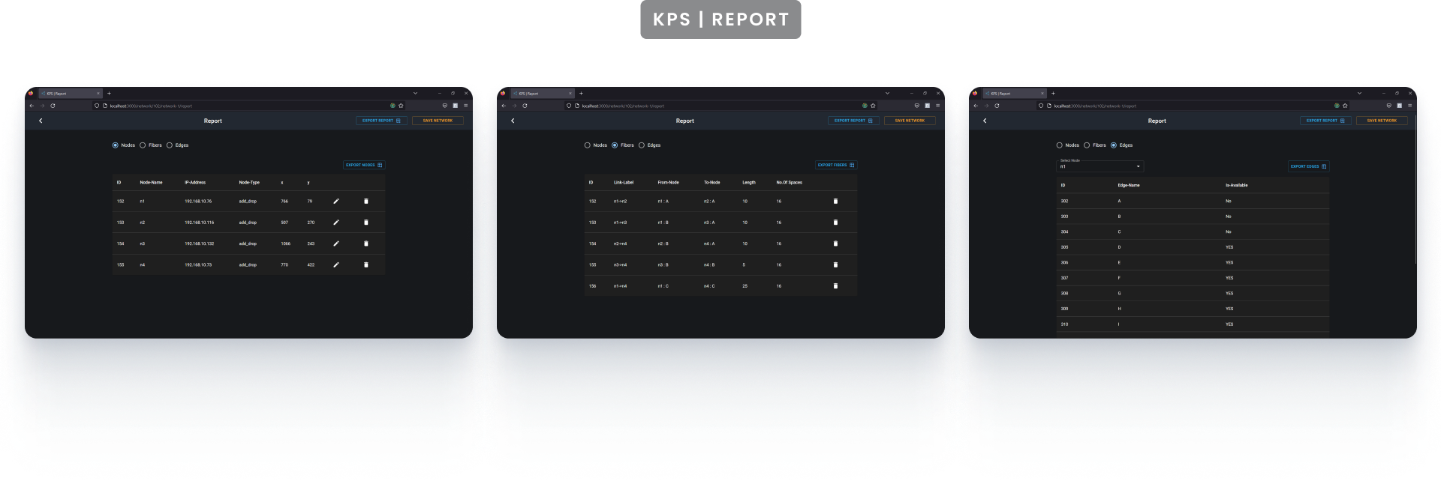


Slide 14
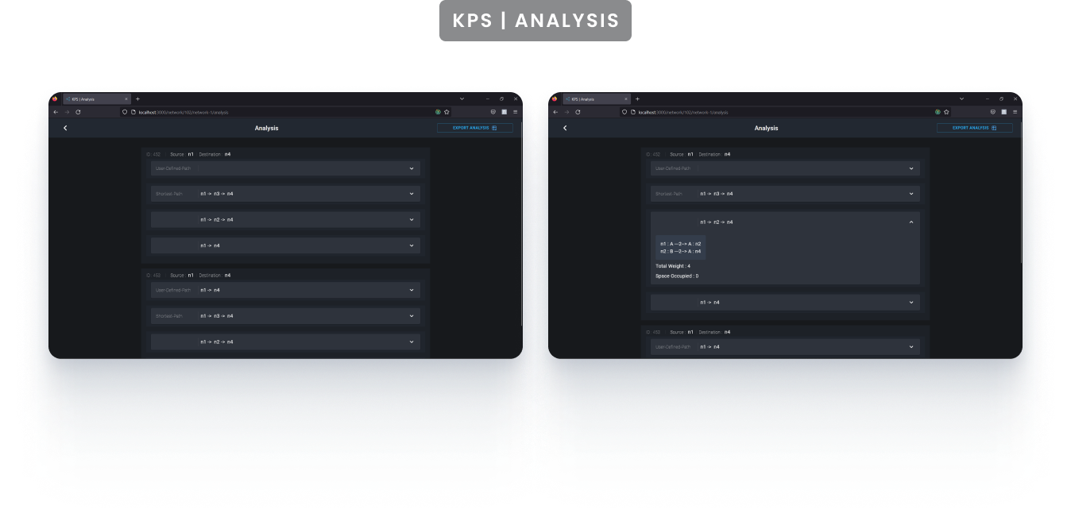


Slide 15
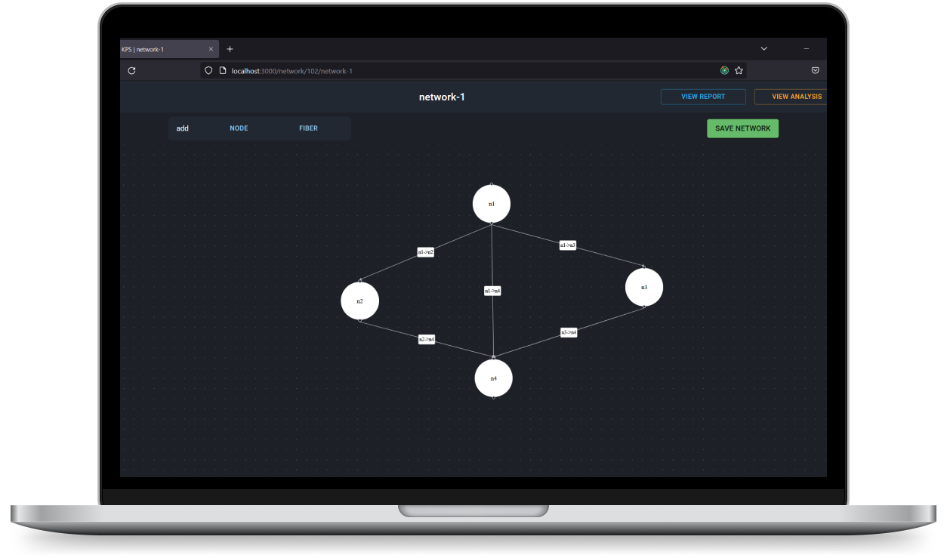


Slide 16

GitHub: https://github.com/NagaSaiRakshith2905/KPS-Project

